Slide 1
Basic Research at the Department of Defense
MRS Spring Annual Meeting
April 2018
Dr. Bindu Nair
Deputy Director for Basic Research
Office of the Under Secretary for Research and Engineering
Department of Defense

Slide 2
How does DoD define basic research?
DoD policy states that basic research is the “systematic study directed toward greater knowledge or understanding of the fundamental aspects of phenomena and of observable facts…”
Notes:
(Codified in DoDI 3210.1 dated September 16, 2005 Administration and Support of Basic Research by the Department of Defense)

Slide 3
Funding across the DoD Basic Research Enterprise
Total
$2.3B
Over two-thirds of funds to extramural programs
Major funder of basic research in math, physics, and engineering

Slide 4
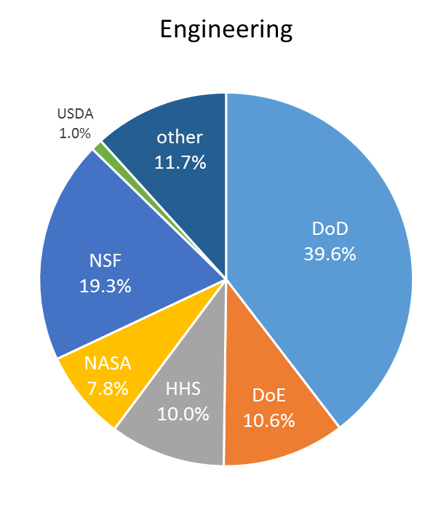
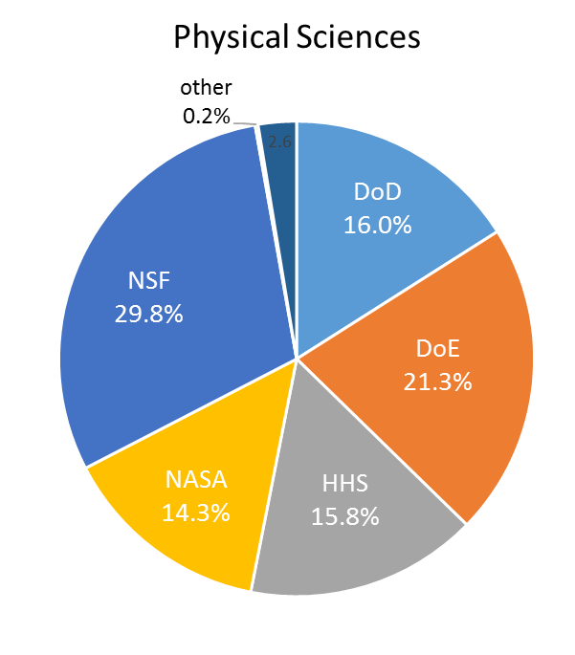
R&D Funding by Agency
DoD third largest funder of basic research to universities
Source: NSF, National Center for S&E Statistics, special tabulations (2017) of Higher Education R&D Development Survey (HERD).

Slide 5
DoD Basic Research Office in the
Office of the Secretary of Defense
Provide Scientific Focus & Departmental Oversight
Maximize
Discovery
Potential
Ensure
Balance & Coherence
OSD
Basic
Research
Office
Foster DoD
Connections
Attract Top
Researchers

Slide 6








Oversee and Connect
Across DoD Offices & Agencies
With Other Government Agencies
With Institutions of Higher Education

Slide 7

Cultivate and Collaborate
Vannevar Bush Faculty Fellowship
Multi-University Research Initiatives
(MURIs)
National Defense Science and
Engineering Graduate Fellowship
Programs to develop ideas and people

Slide 8
Ongoing Programs

Slide 9
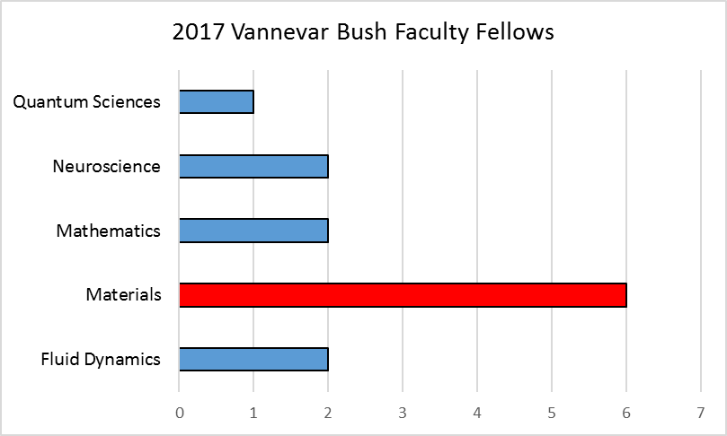
Vannevar Bush Faculty Fellowship
Defense Department’s largest single-investigator program:
5-year fellowship with up to $3M for research with potentially extraordinary outcomes
Program Goals:
  Support transformative, high-risk, basic research
  Attract distinguished, productive, and creative candidates and sustain career-long association between Fellows and DoD
  Establish a group of experts that can study and advise DoD on emerging scientific and technical challenges

Slide 10


Vannevar Bush Faculty Fellowship
FoA posted by ONR
White papers
due
Full proposals due
Selection of 2019 Class
Defense Department’s largest single-investigator program:
5-year fellowship with up to $3M for research with potentially extraordinary outcomes
*dates are tentative*
Mid-June 2018
August 2018
January 2019
March 2019
(webinar on project eligibility, etc to follow)
Jennifer Lewis
Nader Engheta
Susanne Stemmer
programmable architecture materials
materials for extreme manipulation of light, sound & heat
new thin film
electronic materials

Slide 11
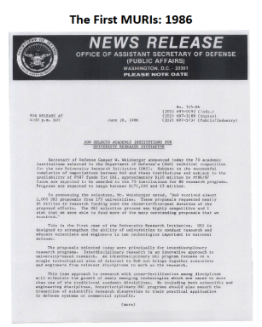
Multidisciplinary University Research Initiative (MURI) Program
Defense Department’s tri-service program that supports basic research teams intersecting with more than one traditional science and engineering discipline
Program Goals:
  Educate scientists and engineers in the interdisciplinary areas important to national defense
  Promote rapid technology transition directly to Service applications
  Complement other DoD programs that support university research through the single-investigator awards.

Slide 12
Multidisciplinary University Research Initiative (MURI) Program
Defense Department’s tri-service program that supports basic research teams intersecting with more than one traditional science and engineering discipline
White paper inquiries and questions
White papers
due
Application inquiries and questions
Applications
due
New funding call out
MURI awards typically five years.
New awards can be funded up to $1.5M/year.
June 15, 2018
June 29, 2018
Oct 2, 2018
Oct 16, 2018
Selected topics from funding call:
Molecularly Programmable Graphene Architecture (MPGA)
Group-IV Alloy Synthesis and Materials Properties
2D Heterostructures for Flexible, Lightweight Electronics and Optoelectronics
Full list: https://www.grants.gov/custom/viewOppDetails.jsp?oppId=302058

Slide 13
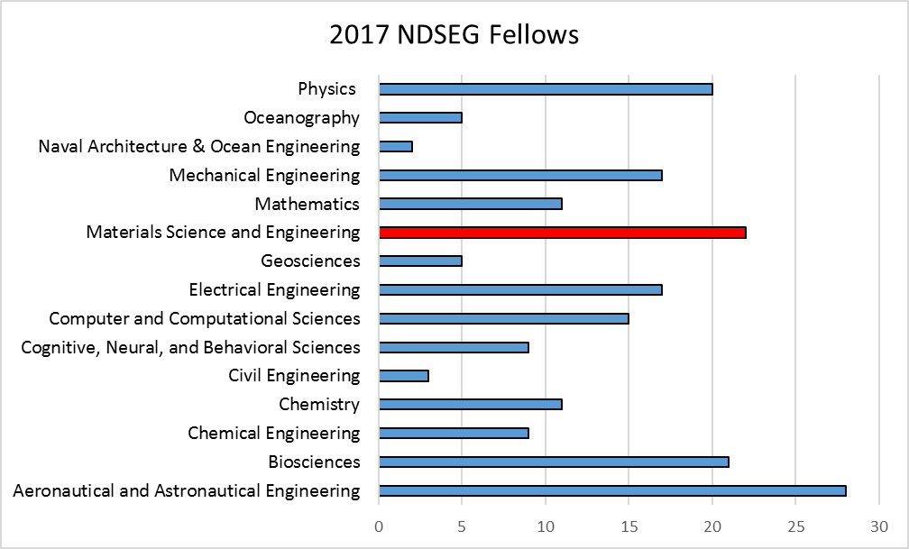
National Defense Science and Engineering
Graduate Fellowship
The NSDEG fellowship supports graduate students in science and engineering disciplines of military importance
http://www.ndsegfellowships.org
Notes:
*195 fellows in FY17,

Slide 14
National Defense Science and Engineering
Graduate Fellowship
The NSDEG fellowship supports graduate students in science and engineering disciplines of military importance
Applications open
Applications due
Panel Review
Awardees
announced
For three years:
Covers full tuition, mandatory fees, & health insurance cost up to $1500/year.
Fellows also receive a monthly stipend of $3200.
*dates are tentative*
September
January
February
Late March/
April
http://www.ndsegfellowships.org/

Slide 15
Pilot Programs

Slide 16
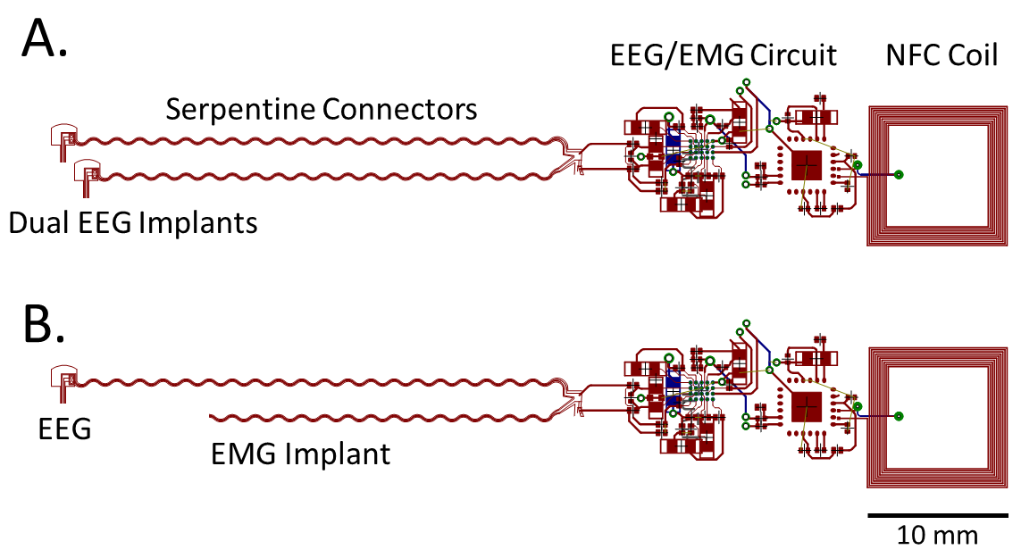
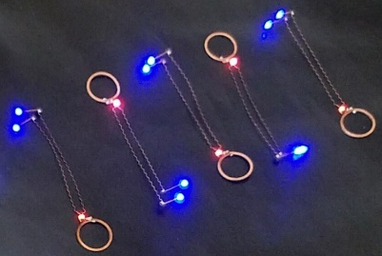
Laboratory University Collaboration Initiative (LUCI)
Funded collaborations between Vannevar Bush Fellows and DoD researchers to understand and address long term DoD needs
Program Goals:
    Encourage collaboration between Vannevar Bush Fellows and DoD researchers to strengthen partnerships
    Support basic research in areas of critical interest to DoD
    16 awards of $600K (awarded over 3 years)
Wireless EEG/EMG implant schematic
Establish in-house animal model of PTSD through collaboration by Dr. Good (2017 Class LUCI Fellow) and Prof. Rogers (2008 Class VB Fellow).
Partner with additional US Army groups to further expand the influence of the LUCI program.

Slide 17
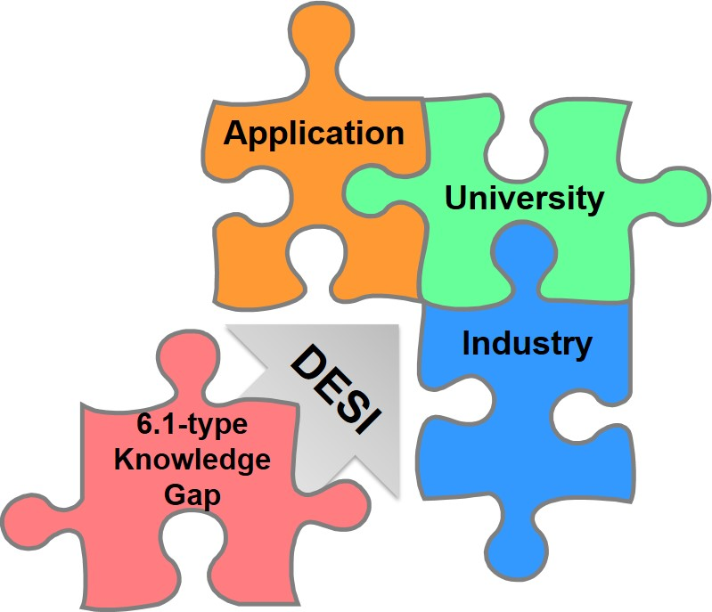
Defense Enterprise Science Initiative (DESI)
Support use-inspired basic research by university-industry teams to look for new solutions and accelerate innovation in DoD capabilities
Key components:
Pilot project to incentivize academia and industry to collaborate
Fund research that focuses on breakthrough defense capabilities (e.g. metamaterials, active composite materials, power beaming)
Fund 4 teams with $750K/year each, over 2 years

Slide 18


I-CORPS @ DoD
Fosters the commercialization of technologies derived from government-funded basic research
Program Goals:
In partnership with NSF, provide researchers with entrepreneurship training and mentorship
Immerse research teams in intensive, curriculum-based program
Create connections and knowledge platforms that advance and sustain innovation
Natural Fiber Welding attracted $1.4 million in venture capital investments and applied for a DoD SBIR award. NFW produces high value materials from low cost, naturally occurring fibers.
http://www.naturalfiberwelding.com/

Slide 19
Materials Enable New Technologies for Defense
discover & design
application
Materials
Research
synthesis
characterization
sensing
health tech
Autonomous systems
energy and power tech
Advanced electronics
& many more!
Notes:
19

Slide 20


Thank you
http://basicresearch.defense.gov/Contact
@DoD_STIx

Slide 22
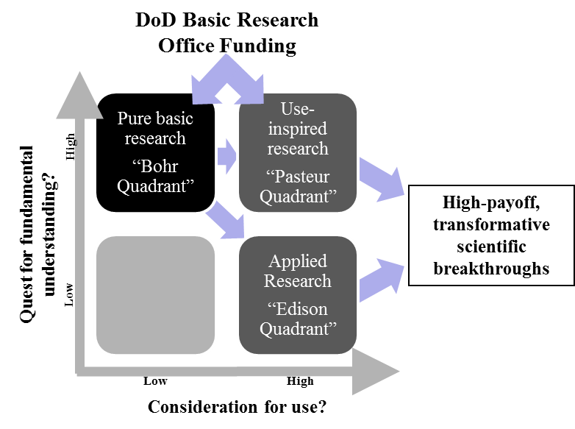
DoD Basic Research Enterprise
Adapted from “Pasteur's Quadrant: Basic Science and Technological Innovation” by Donald E. Stokes, Brookings Institution Press, Mar 1, 2011.

